Slide 1
COE1188 Final Project
By: Matthew Damiani, Michael Mortensen, Kyle Monto, and Elizabeth Shenck

Slide 2
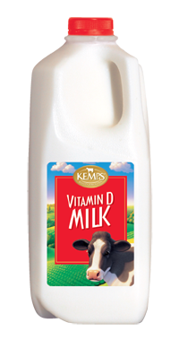
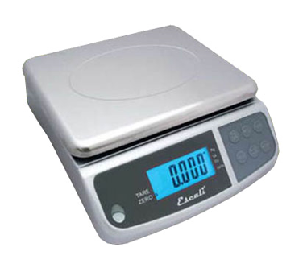
Overview
Scale for milk carton
Gets weight reading every 15 seconds
Converts reading to percentage remaining
Results posted to webpage

Slide 3
System Architecture
MSP432
NodeRed/Bluemix
CC3100
FSR402

Slide 4
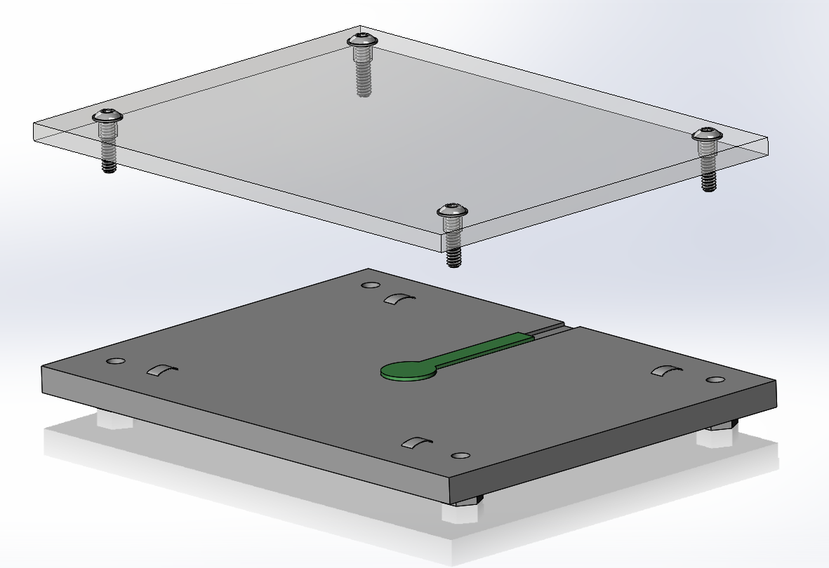
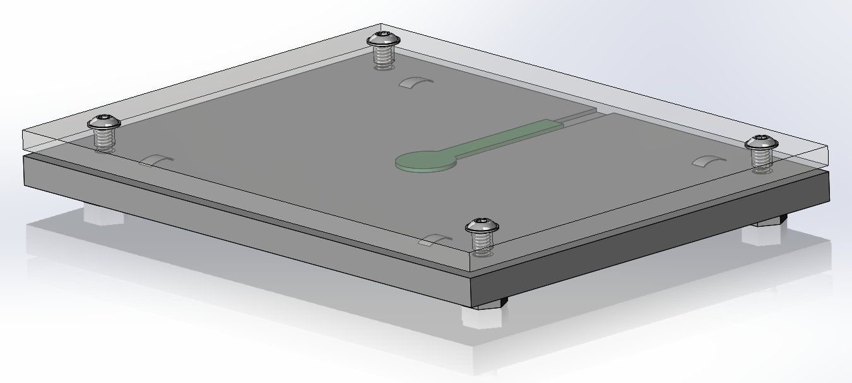
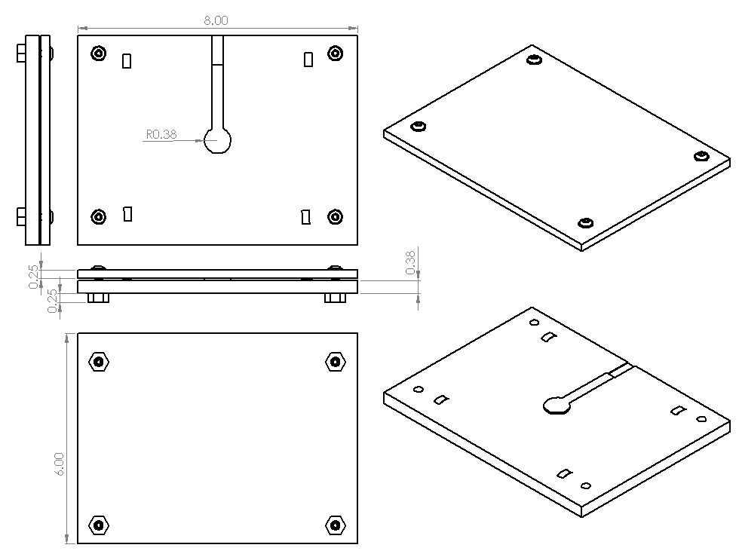
Implementation (Mechanical)

Slide 5
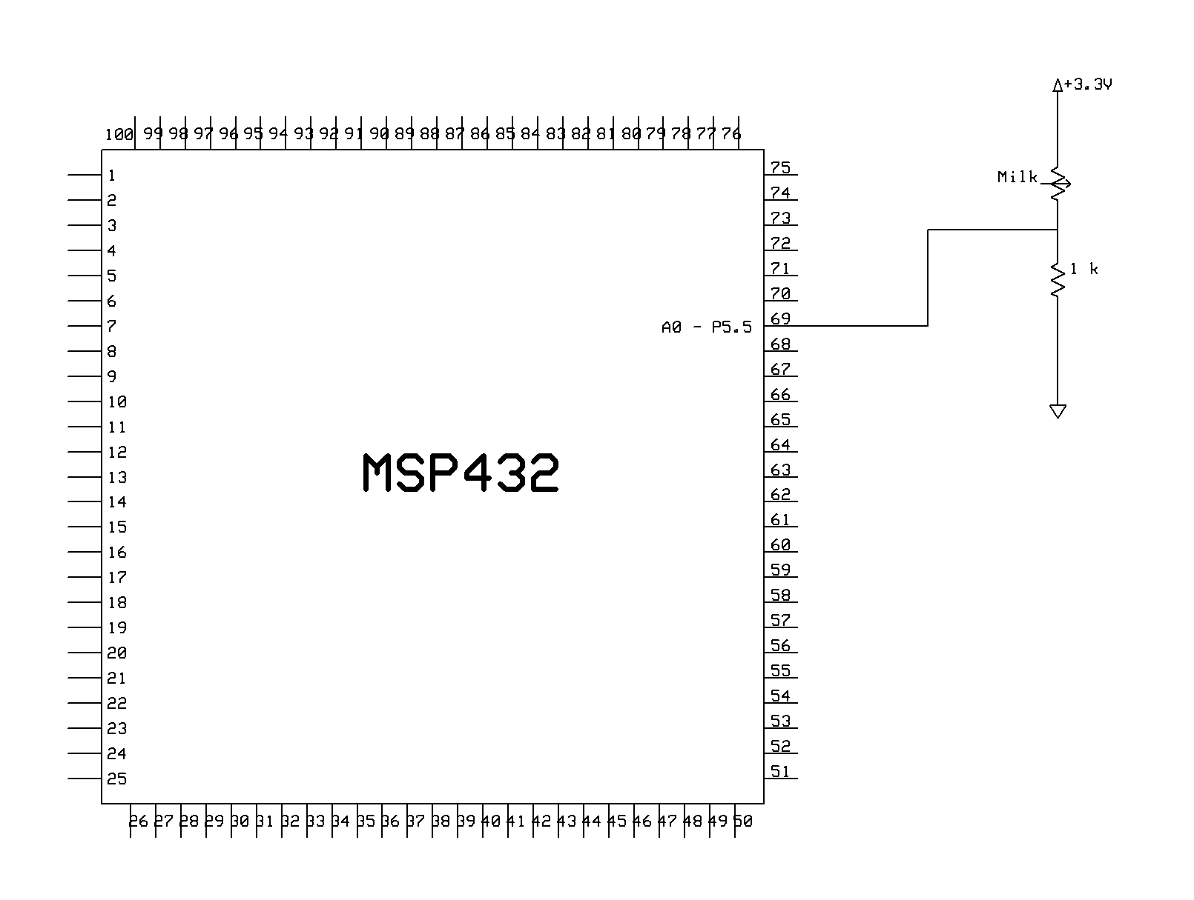
Implementation (Hardware)

Slide 6
Implementation (Software)

Slide 7
Live Demo!!!

Slide 8
If We Had More Time…
Create scales for other refrigerator items (juice, eggs, etc.)
Perform data analysis on milk drinking habits/tendencies (what times of that day do you drink the most milk???)
Send alerts to MSP432 and flash LED if you’re not drinking enough milk

